Slide 1
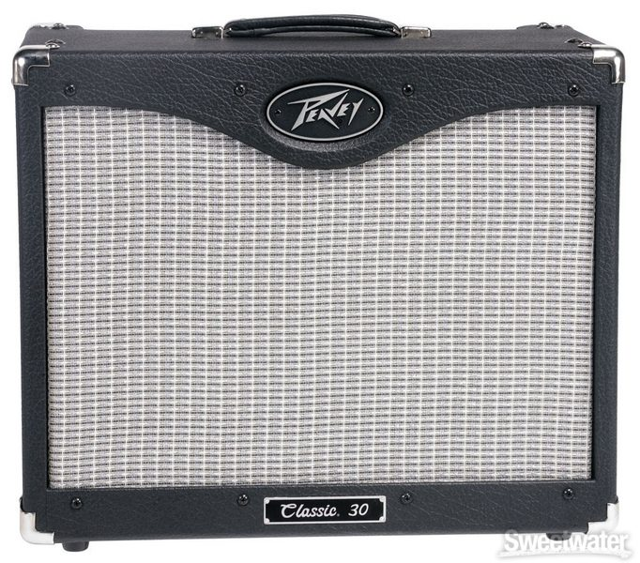
How To Use A Guitar Amp

Slide 2
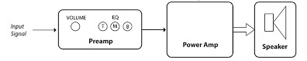
What Does An Amplifier Do?
Power amp: Boosts signal for speaker output
Preamp: Boosts signal for tone processing

Slide 3
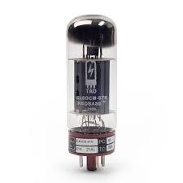
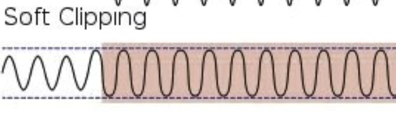
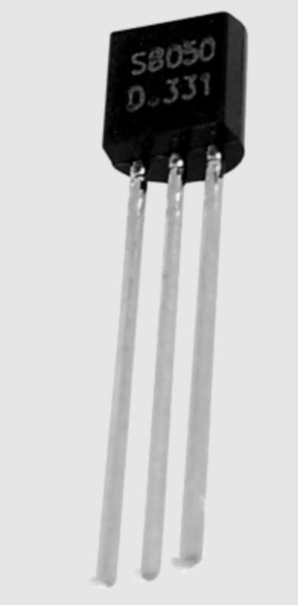
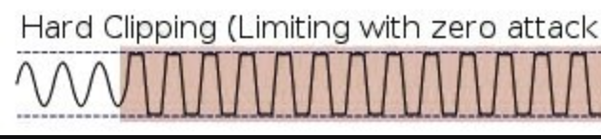
Tube vs Solid State
Tube amps create a softer clipping effect known as “overdrive” and are more responsive to playing dynamics.
Solid-state amps create a hard clipping effect known as “distortion”.

Slide 4
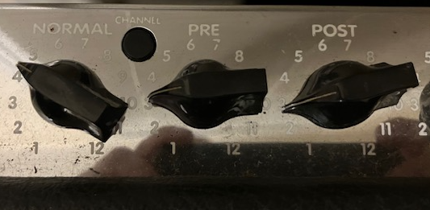
Clean vs. Lead Channel Controls
“Channel” button: Switches to lead channel
“Pre”: Sets overdrive on the lead channel.
“Normal”: Sets the volume on the clean channel
“Post”: Sets volume on the lead channel.

Slide 5
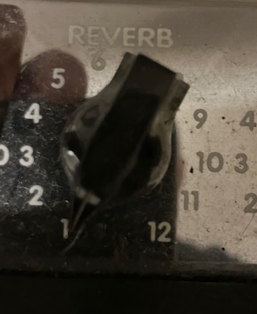
Reverb Control
Reverb produces an echoing effect that mimics the sound of sound waves reflecting off of surfaces.
Reverb: Sets echo effect the amp simulates.

Slide 6
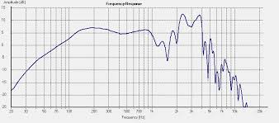
The Frequency Spectrum
A musical sound is a complex wave composed of many individual sound waves resonating at many different frequencies across the audible spectrum.
The tone controls can be used to control the shape of the complex waveform.
Middle
Bass
Treble

Slide 7
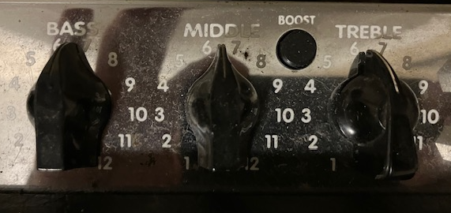
Tone Controls
“Boost”: Boosts the middle frequencies levels
Middle: Controls the middle frequencies levels
Bass: Controls the lower frequencies levels
Treble: Controls the higher frequencies levels

Slide 8
Let’s Jam
Experiment with the amp’s controls while we jam!
What sounds can you create?

Slide 9
Quiz #1
What kind of clipping do tube and solid state transistors produce, respectively?
What do the pre and post knobs do?
Describe the effect the reverb knob creates?
The bass, mid, and treble knobs control what areas of the frequency spectrum, respectively?

Slide 10
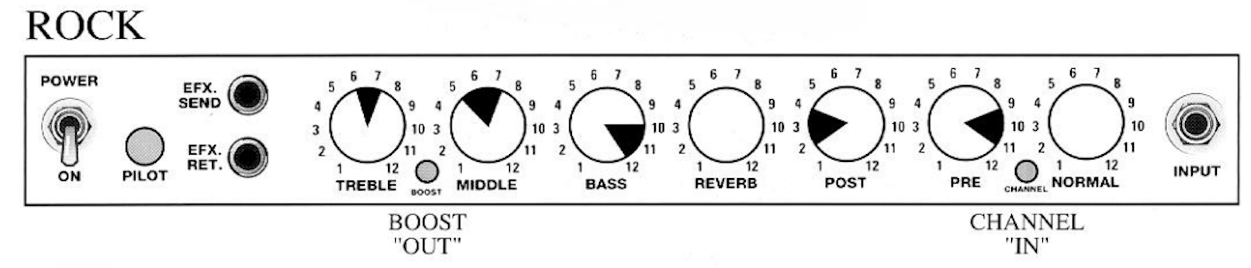
Rock Settings
Let’s start experimenting with different settings for different styles of music
Notice that each has a range you can choose from.
What do you stands out about these settings for “rock” guitar?

Slide 11
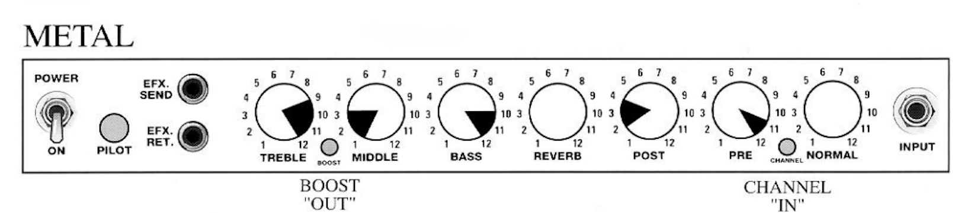
Metal Settings
Now experiment with these settings ranges for “metal” guitar.
How do they compare to the “rock” settings?

Slide 12
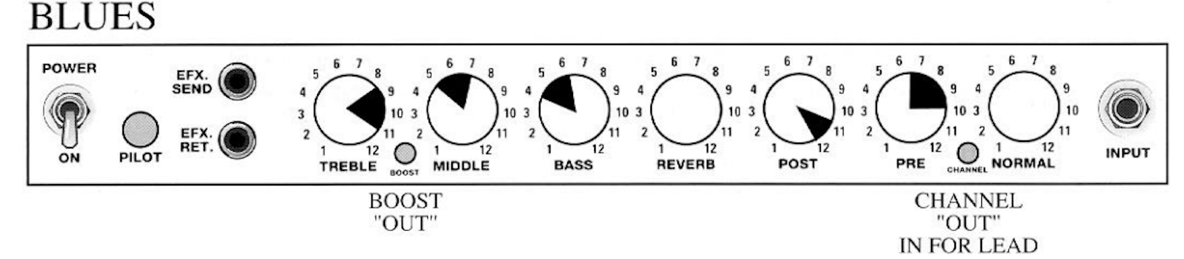
Blues Settings
Now experiment with these settings ranges for “blues” guitar.
How do they compare to the “rock” and “metal” settings?

Slide 13
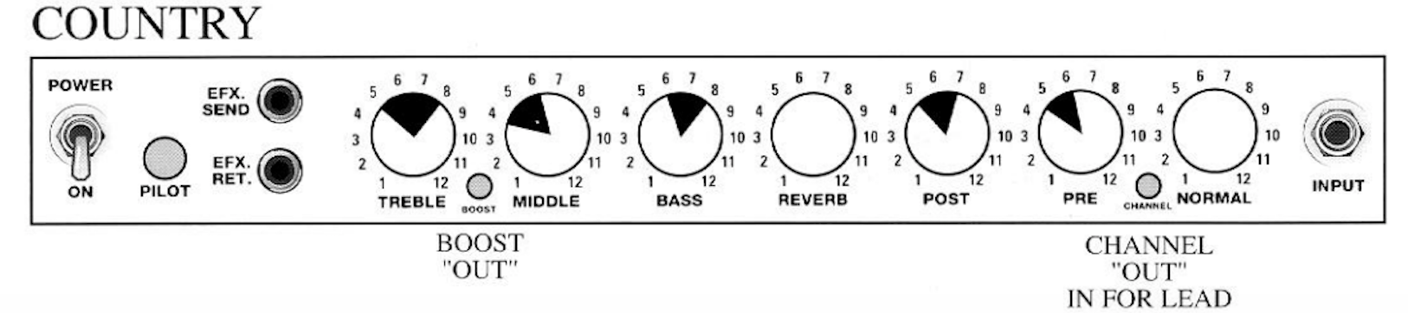
Country Settings
Now experiment with these settings ranges for “country” guitar.
How do they compare to the “blues” settings?

Slide 14
Quiz #2
Which genre sets the “pre” knob the highest?
Which genre sets the “pre” knob the lowest?
Which two genres set the bass knob control between 10 and 12?
Which genre sets treble the highest?

Slide 15
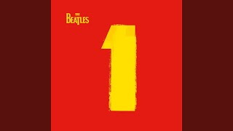
Copy The Tone
Let’s use what we have learned about the guitar amp to copy the guitar tone to “Day Tripper” by The Beatles.
Listen carefully to the guitar part and adjust your guitar and amp controls until your guitar sounds as close to the recording as possible

